Slide 1

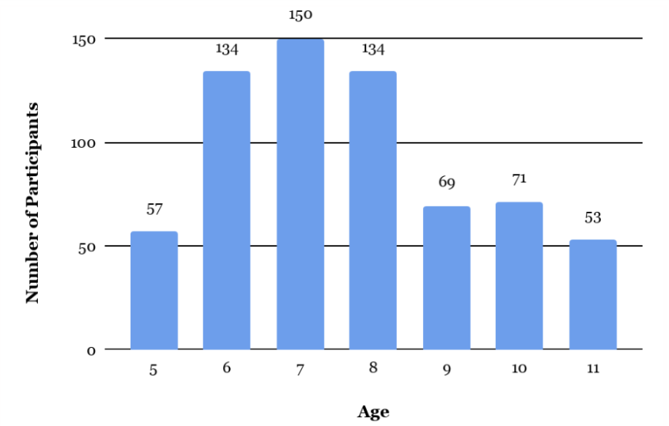
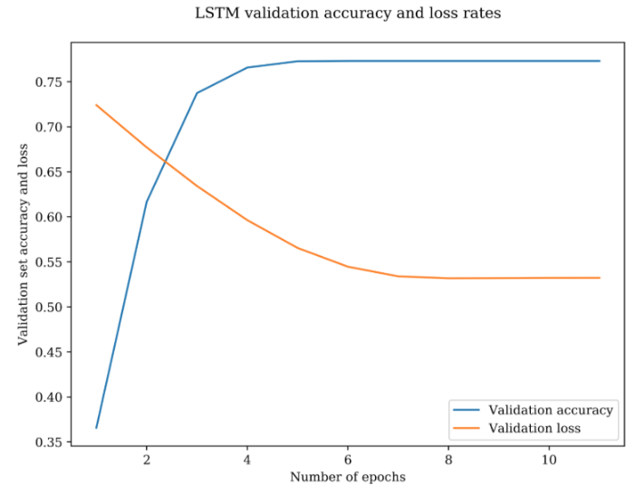
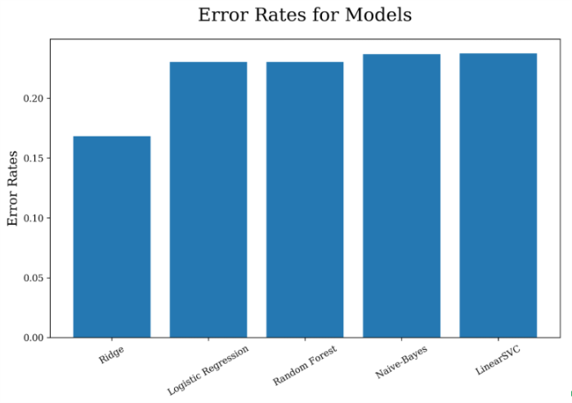
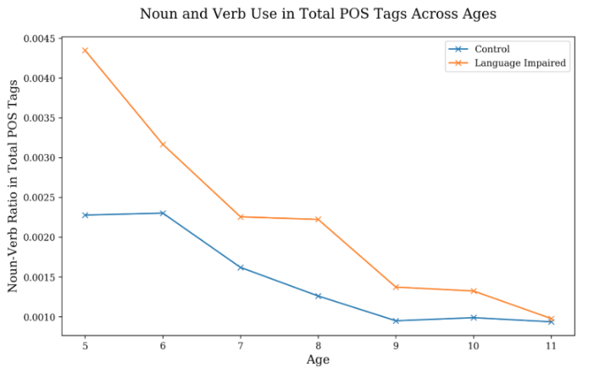
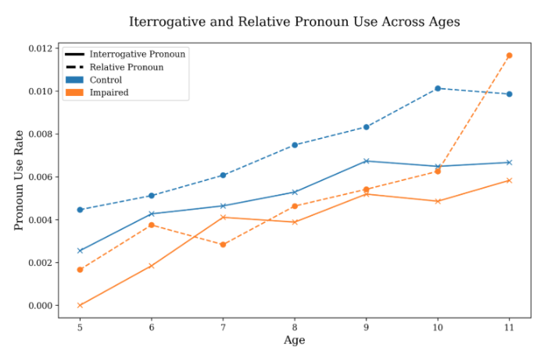
Part-of-Speech Tags, Age, and Language Impairment -
A Language Production Analysis using Machine Learning Techniques
University of Chicago
Delores Tang
Introduction
Methods
ID | Gloss | POS tags | Impaired | Age | POS tags frequencies | N:V | N+V Total
0 | “I love bacon” | [pro:sub, v, n] | 0 or 1 | 5 | (42 unique tags)
“Nouns before Verbs”
Dataset
Children’s ability to acquire verbs seemed to lag behind their ability to acquire nouns
Past literature primarily focused on children under age of 5.
Childes (Child Language Data Exchange System)
Gillam Corpus
Test of Narrative Language (TNL)
McDonald's storytelling
Typical:171; Impaired: 497
Preliminary Analysis
Word-Based Analysis
POS-Based Analysis
Natural Partition vs. Linguistic Relativity
Output: Age
Noun-Verb Ratio One-way ANOVA
Noun+Verb/Total Least squares
All POS/Total Least squares
Impair vs. Typical t-test
Word Embeddings:
GloVe
Word2Vec
Output: Impairment
Naive Sequential
Simple RNN
LSTM
Random Forest
Output: Age
Simple RNN
Random Forest
Vectorizer:
TF-IDF vectorizer
Output: Impairment
Logistic Regression
Naive-Bayes
Linear SVM
Ridge/Lasso/Elasticnet
Random Forest
Output: Age
Logistic Regression
Natural Partition: pattern emerged because of the abstract/concrete distinction in how humans perceive objects and events.
Linguistic Relativity: English language is Noun-focused.
Was not supported by cross-cultural studies.
Noun-Verb Distinction
Part-of-speech (POS)
Structure Complexity
Information needed
Word Imageability
Ease to make mental representations
Language Impairment
Results & Discussion
Preliminary Analysis
N:V ratio insignificant in relation to Age
N+V was negatively correlated to Age
Interrogative ('what') and relative ('where') pronouns are more frequently used as Age increases
Discussion:
Children use more complex sentence structures (more clauses) as they grow older.
This trend differs for children with typical and impaired language abilities.
The differences seem to converge as both groups grow older.
Word-Based Analysis
GloVe embedding returns better results.
Simple RNN stacked with LSTM as the best model
However, validation accuracy stopped increasing at 0.7731 due to insufficient data
Diagnosis for Specific Language Impairment (SLI):
Receptive: information processing, understanding;
Expressive: spelling & vocabulary, simpler sentences;
inappropriate/insufficient utterances.
Lack of evidence on specific linguistic structures.
Research Question:
Do children across ages (5-11) produce languages with different structures (e.g., in terms of POS tags)?
Does the trend differ between children with typical and impaired language abilities?
References
Gillam, R. B. & Pearson, N. (2004). Test of Narrative Language. Austin, TX: Pro-Ed Inc.
MacWhinney, B. (2000). The CHILDES Project: Tools for analyzing talk. Third Edition. Mahwah, NJ: Lawrence Erlbaum Associates.
Mikolov, T., Sutskever, I., Chen, K., Corrado, G.S., & Dean, J. (2013). Distributed Representations of Words and Phrases and their Compositionality. NIPS.
Pennington, J., Socher, R., & Manning, C. D. (2014). GloVe: Global Vectors for Word Representation.
Sanchez, A., Meylan, S., Braginsky, M., MacDonald, K. E., Yurovsky, D., & Frank, M. C. (2018, April 23). childes-db: a flexible and reproducible interface to the Child Language Data Exchange System. Retrieved from psyarxiv.com/93mwx
POS-Based Analysis (bigrams & trigrams)
Model selection: Ridge
Feature Importance: Bigrams with a pronoun paired with a noun (pro, n), determiner (det, n) is most relevant to Age.
Specific types of clauses are learned before others
More detailed linguistic analysis would be needed
Children in this data already passed acquisition stage.

